Slide 1
Data Structure and Algorithm CSE-225
Dr. Mohammad Abu Yousuf
yousuf@juniv.edu

Slide 2
Queue

Slide 3
A queue is a linear list of elements in which deletion can take place only at one end, called the front, and insertions can take place only at the other end, called the rear.
The term “front” and “rear” are used in describing a linear list only when it is implemented as a queue.

Slide 4
There are main two ways to implement a queue :
1. Circular queue using array
2. Linked Structures (Pointers)
When a queue is implemented using array, that queue can organize only limited number of elements.
When a queue is implemented using linked list, that queue can organize unlimited number of elements

Slide 5
Primary queue operations:
Enqueue: insert an element at the rear of the queue
Dequeue: remove an element from the front of the queue

Slide 6
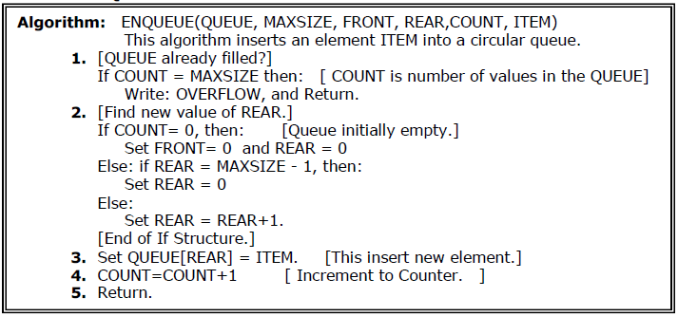
Insertion in Queue

Slide 7
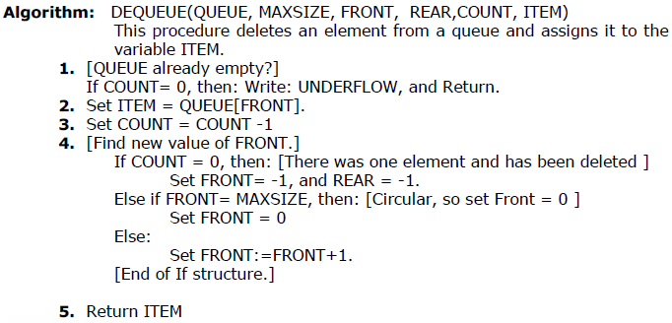
Deletion in Queue

Slide 8
Queue Example
Following Figure shows that how a queue may be maintained by a circular array with MAXSIZE = 6 (Six memory locations).
Observe that queue always occupies consecutive locations except when it occupies locations at the beginning and at the end of the array.
If the queue is viewed as a circular array, this means that it still occupies consecutive locations. Also, as indicated by Fig(k), the queue will be empty only when Count = 0 or (Front = Rear but not null) and an element is deleted.
For this reason, -1 (null) is assigned to Front and Rear.

Slide 9
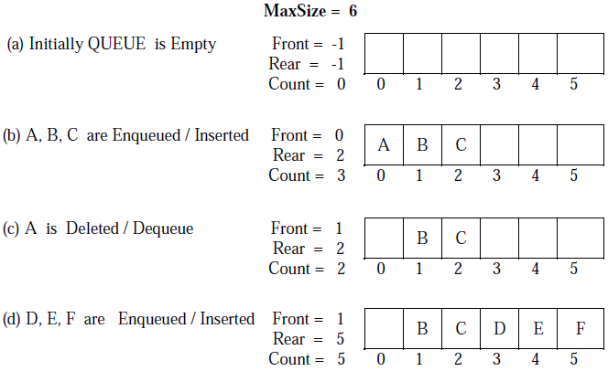

Slide 10
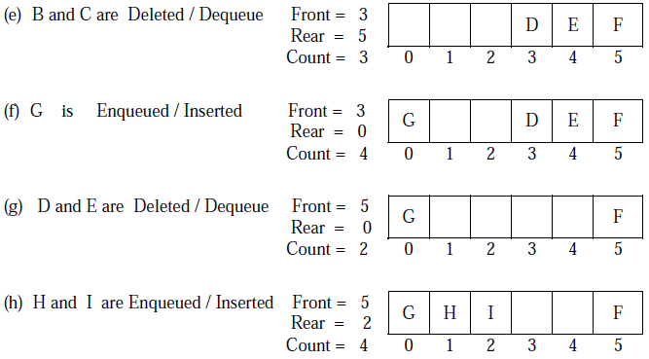

Slide 11
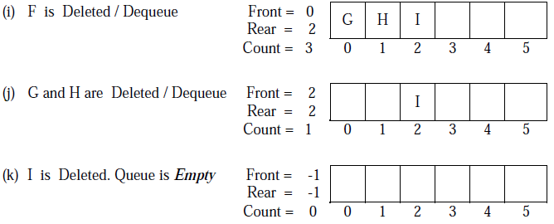

Slide 12
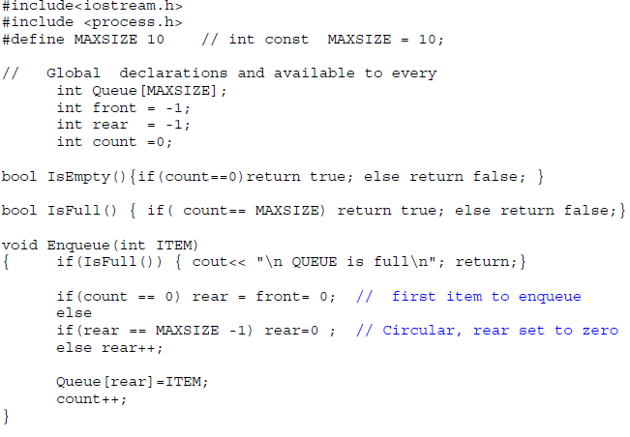
C++ Code to implement Circular QUEUE using array

Slide 13
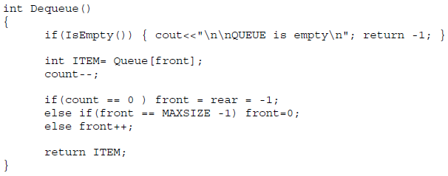
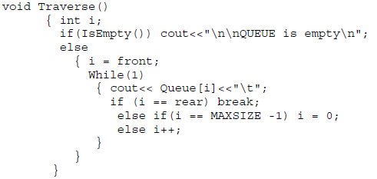
C++ Code to implement Circular QUEUE using array

Slide 14
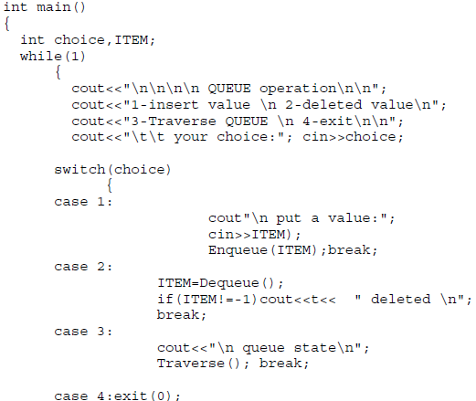

C++ Code to implement Circular QUEUE using array

Slide 15
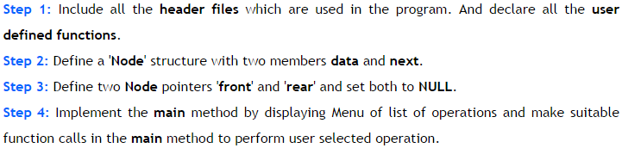
Queue using Linked List
In linked list implementation of a queue, the last inserted node is always pointed by 'rear' and the first node is always pointed by 'front'.
To implement queue using linked list, we need to set the following things before implementing actual operations.

Slide 16
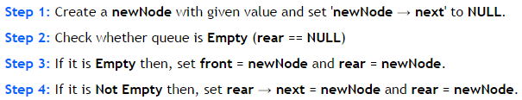
Queue using Linked List
enQueue(value) - Inserting an element into the Queue:

Slide 17
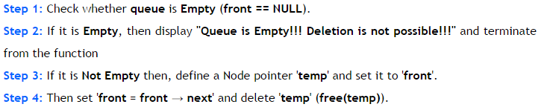
Queue using Linked List
deQueue() - Deleting an Element from Queue:

Slide 18
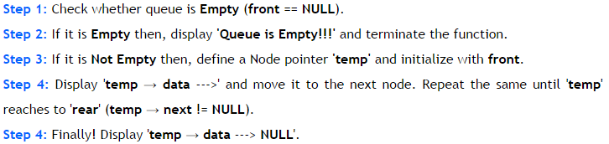
Queue using Linked List
display() - Displaying the elements of Queue:

Slide 19
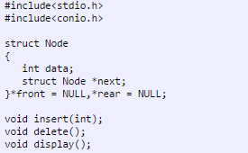
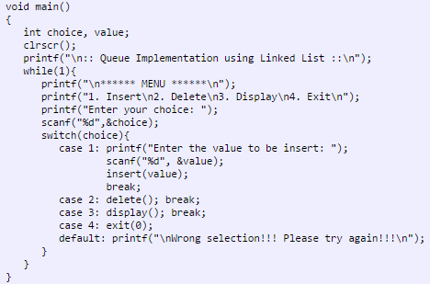
Program for Queue Using Linked List

Slide 20
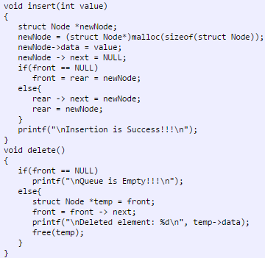
Program for Queue Using Linked List

Slide 21
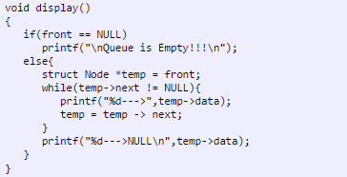
Program for Queue Using Linked List

Slide 22
Thank You

